Slide 1
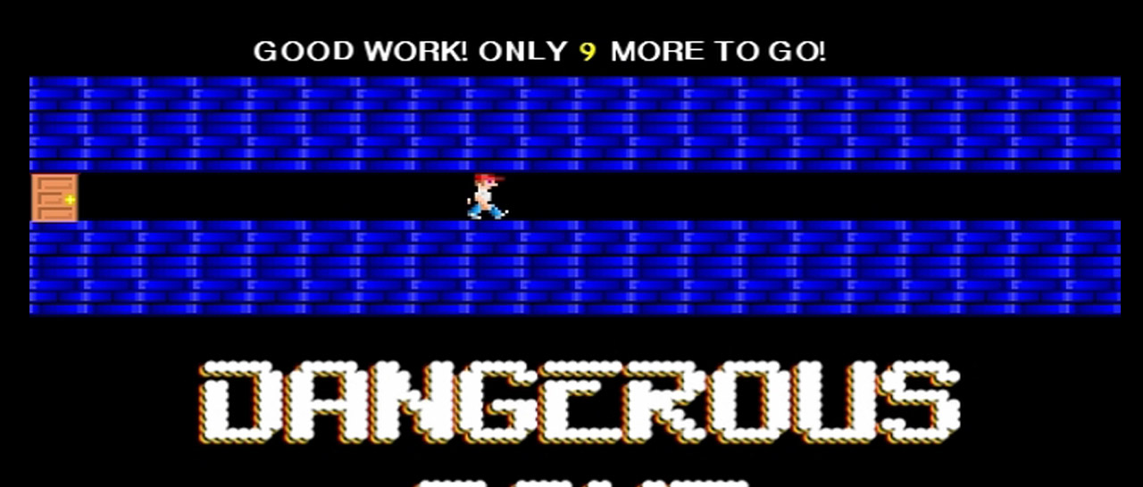
DANGEROUS DAVE GAME AUTOMATA
Names/Reg No: Akhil Vandanapu/BL.EN.U4CSE17138
Sourabh Sooraj/BL.EN.U4CSE18118
Sreedathan G/BL.EN.U4CSE18119
Subject/Course Code: Theory of Computation/15CSE303

Slide 2
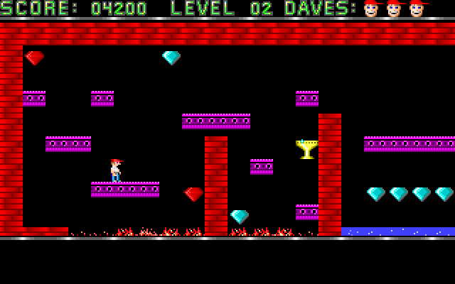
Intro & History
Dangerous Dave is a 1988 computer game by John Romero. It was developed for the Apple II and MS-DOS as an example game to accompany his article about his GraBASIC, an Applesoft BASIC add-on, for the UpTime disk magazine. The object of the game is to collect gold cups to move on to the next level. Since the original 1988 publishing of Dangerous Dave on UpTime, there have been three sequels and three ports of the original to other platforms. The idea for Dangerous Dave came to John Romero under the influence of Super Mario.

Slide 3
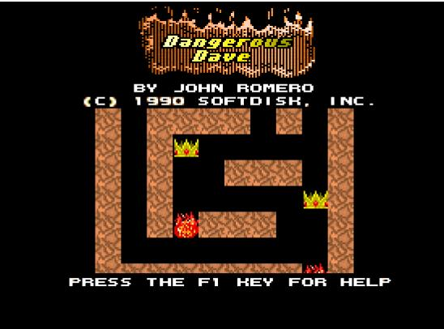
Abstract
The objective here is to understand the level design and form a DFA of the various forms of terrain that Dave navigates through, and form a reasonable deduction considering all the possibilities of where he could end up. The player wins the level by collecting the rare gem and proceeding to the exit. Incase the gem wasn’t collected, and the player attempts to exit, he will be sent to the start(initial state) instead. The player will also have to be wary of traps and falling into flames.

Slide 4
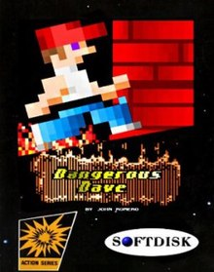
Problem Statement
We will have to design a DFA that accepts a string of characters that pertain to the different directional keys. Using this, each block that Dave navigates is considered a state by itself. We will have to program the DFA to accept all the strings that would allow Dave to win the game by successfully collecting the gem firsthand. Also to program the other possibilities of what would happen incase Dave landed in a trap, etc.

Slide 5
Technology Stack
JFLAP 7.1

Slide 6
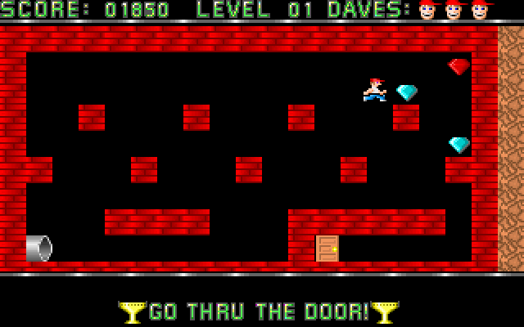
DESIGN

Slide 7
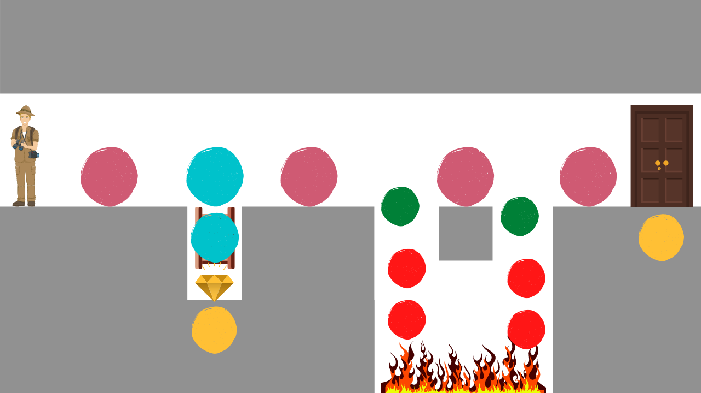
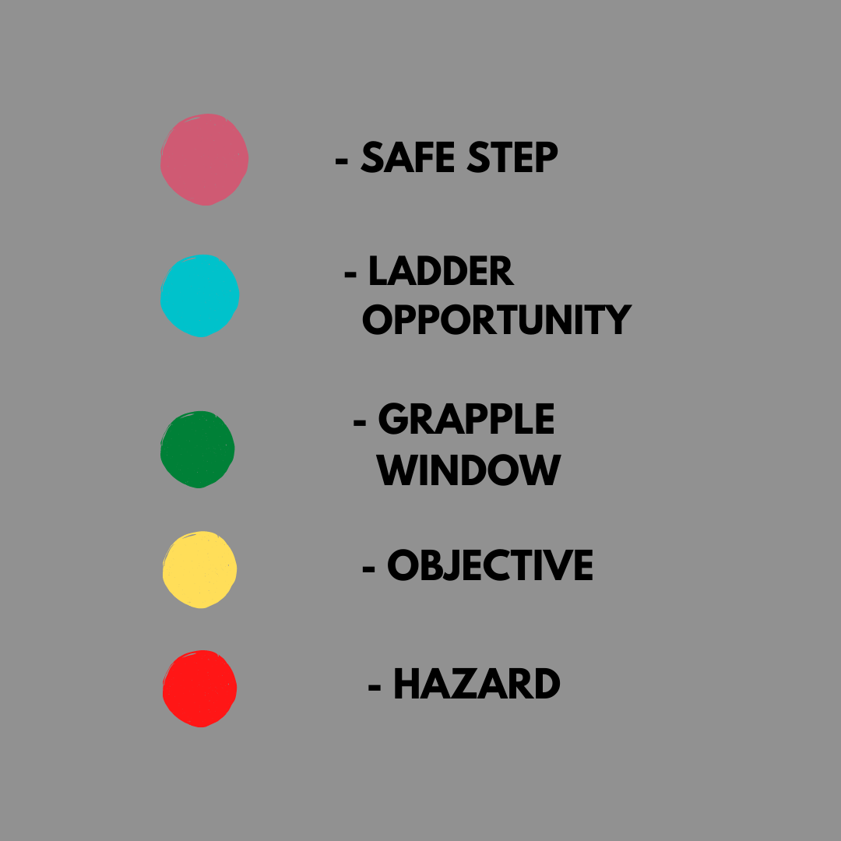
Level 1

Slide 8

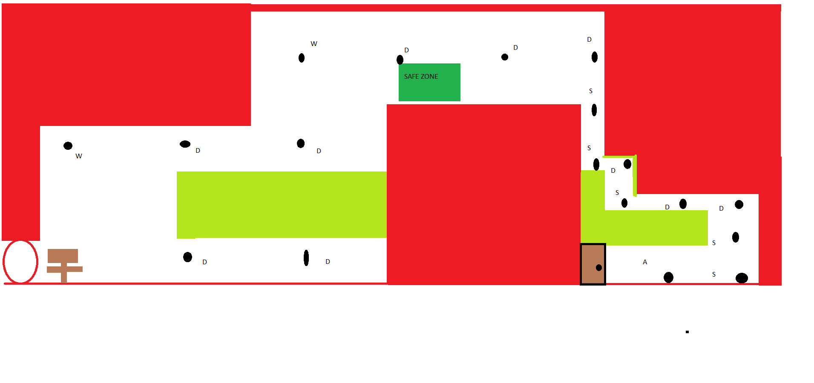

Level 2

Slide 9
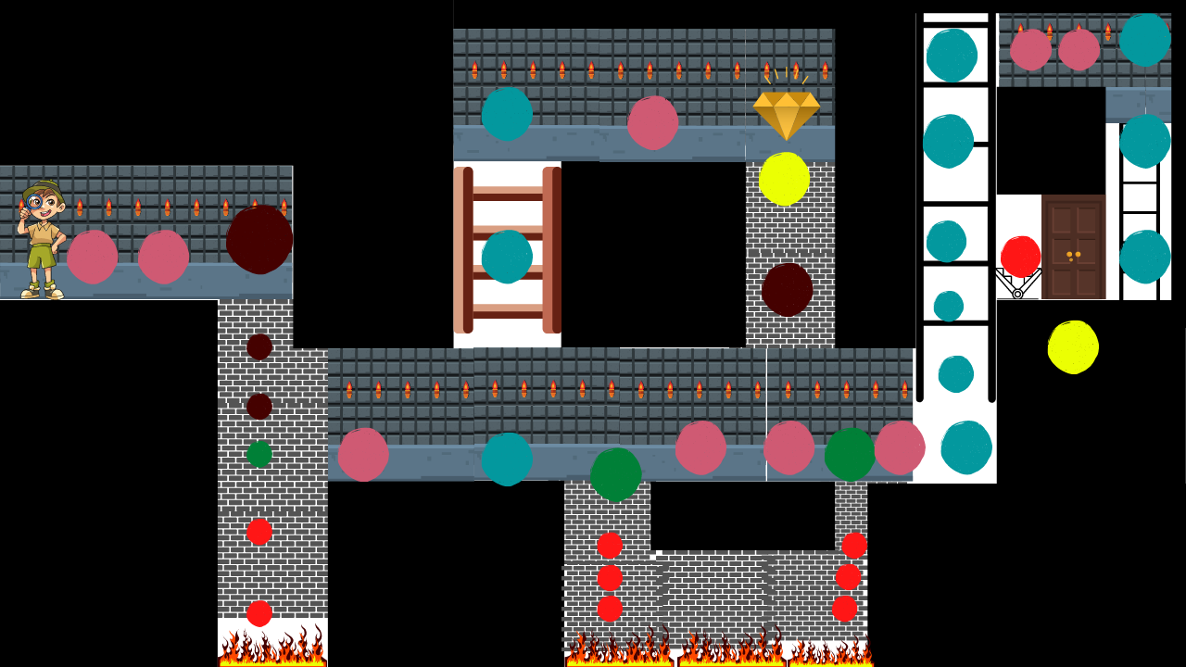
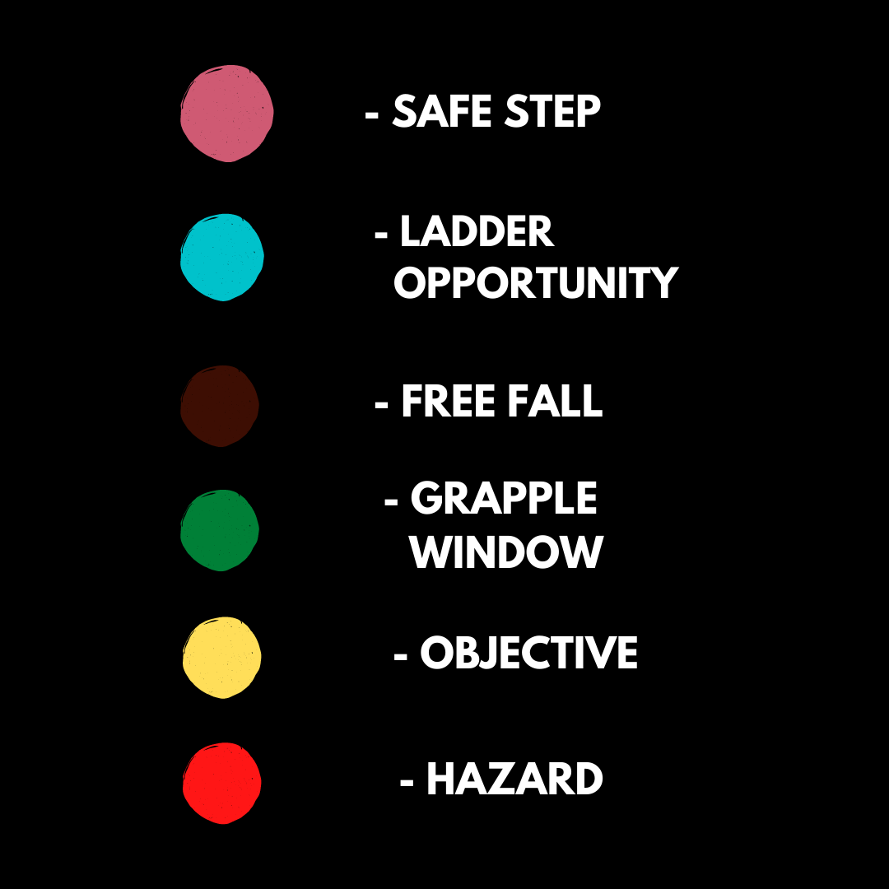
Level 3

Slide 10
IMPLEMENTATION

Slide 11
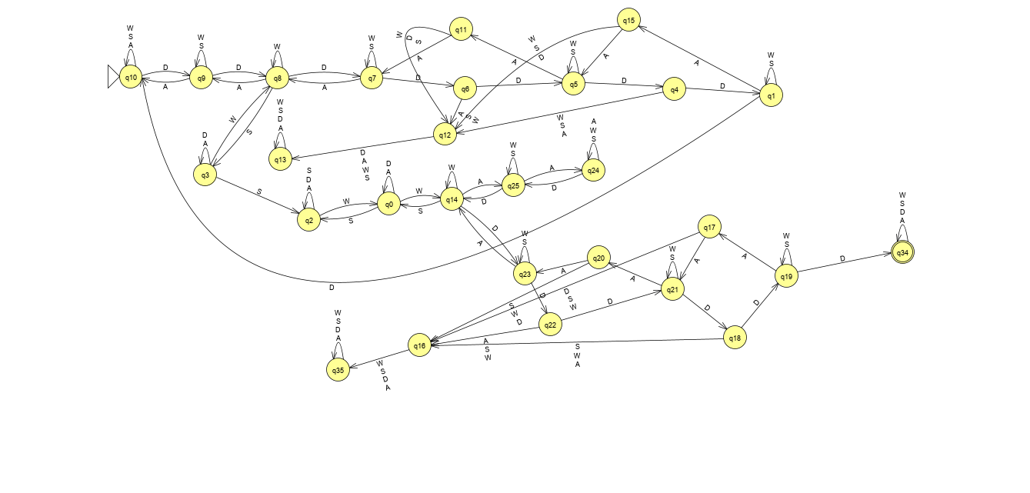
Level 1

Slide 12
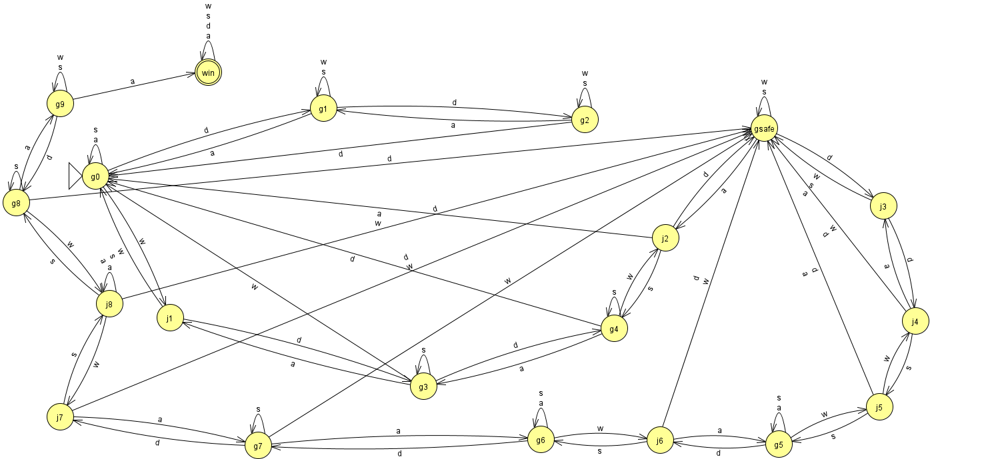
Level 2

Slide 13
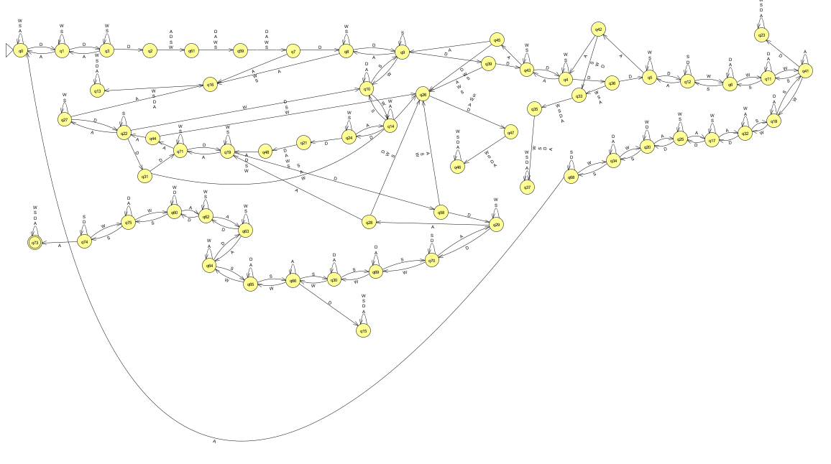
Level 3

Slide 14
TESTING AND RESULTS

Slide 15
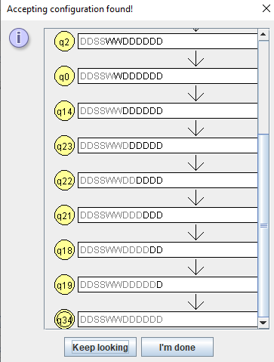
Level 1
Input Accepted and it terminates at win.
Input Rejected.
DDSSWWDDAWS

Slide 16
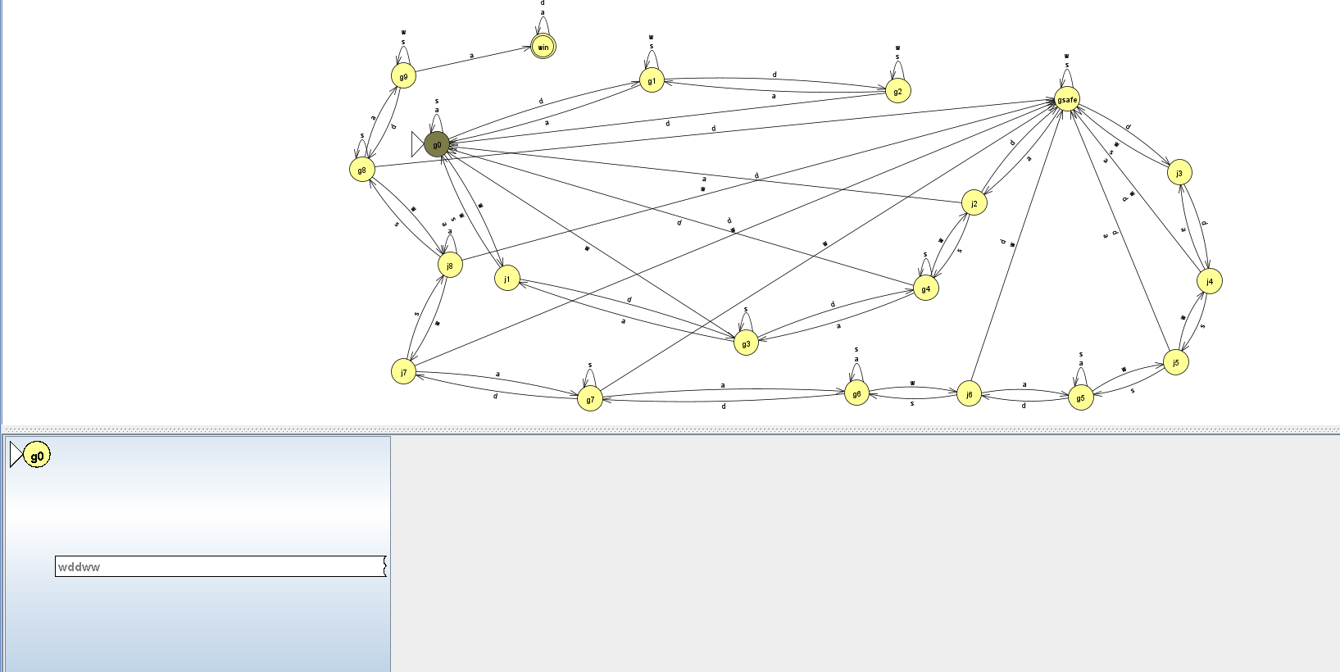
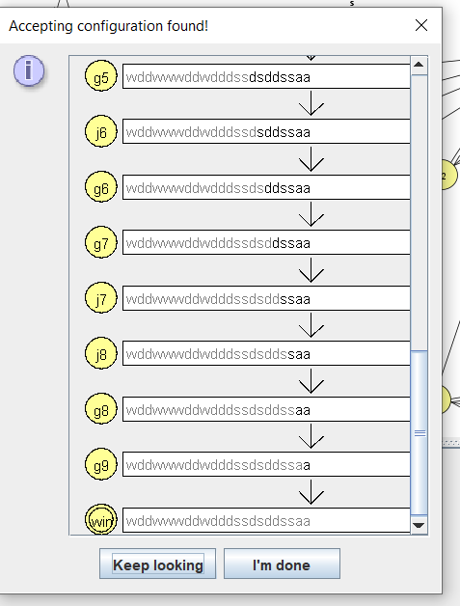
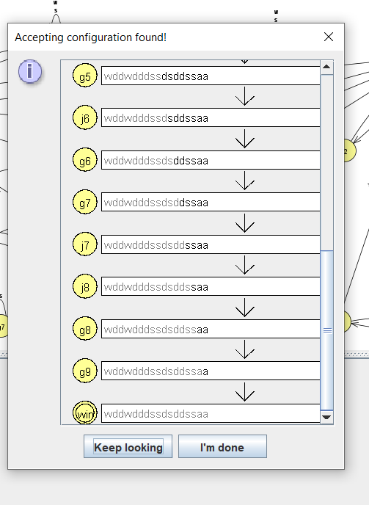
Level 2

Slide 17
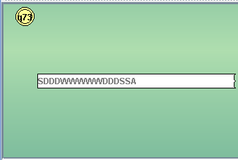
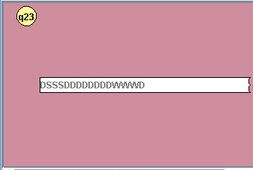
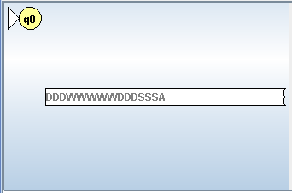
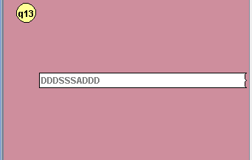
Level 3
Typical/Fastest success
scenario
Typical scenario when run
into booby trap
Typical scenario for restart
(Failure to collect gem)
Typical scenario when
Falling into pit

Slide 18
CONCLUSION
We have successfully designed DFAs for running a few levels inspired by the Dangerous Dave game. We have understood how designing Automatas as such would help the video game industry in a massive way. It helps the developers to program different choices that the player can make to arrive at different outcomes, this was a basic implementation, but with advancements in technology, we could move on to more advanced implementations and trace games and their different outcomes more effectively. This will help in better level building and the earlier stages of game designing.

Slide 19
References & Bibliography
https://www.youtube.com/watch?v=3SX43rZaBa4&ab_channel=RowanRobots
http://www.jflap.org/
https://www.canva.com/
Microsoft Paint
College study materials (Notes, slides, …)

Slide 20

Thank you

